Slide 1
Chapter 4 Semiconductor Memories (Ref- Kang ch-10) EXTC – TE – DVLSI Swati Rane Assistant Professor Dept. of Electronics and Telecommunication SIES Graduate School of Technology
DVLSI

Slide 2
Introduction
All digital systems require semiconductor memory arrays capable of storing large quantities of digital information.
The amount of memory required in a particular system depends on the type of application.
In general, the number of transistors utilized for the information storage is much larger than the number of transistors used in logic operations and for other purposes.
The ever-increasing demand for larger data storage capacity has driven the fabrication technology and memory development towards more compact design rules and, consequently, toward higher data storage densities.

Slide 3
Important criterion of the memory
Area efficiency - the number of stored data bits per unit area → determine the overall storage capacity and cost per bit.
Memory access time - the time required to store and/or retrieve a particular data bit in the memory array → determines the memory speed.
Static and dynamic power consumption → significant factor to be considered in the design.
Memory circuits are generally classified according to the type of data storage and the type of data access.

Slide 4
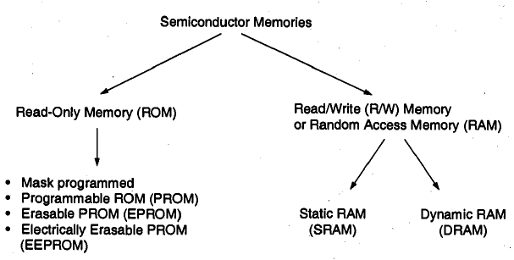
Memory Classification

Slide 5
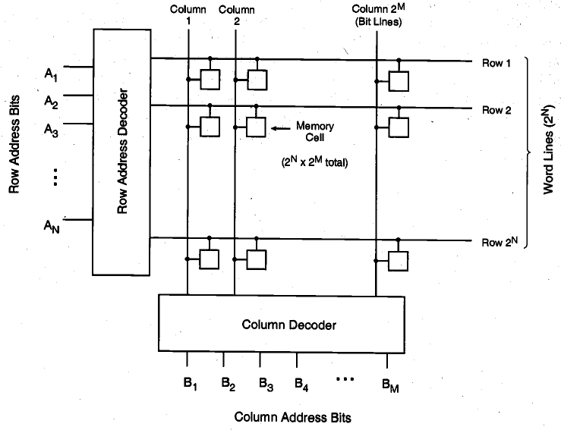
Random-access memory array organization

Slide 6
Random-access memory array organization
The data storage structure, or core, consists of individual memory cells arranged in an array of horizontal rows and vertical columns.
Each cell is capable of storing one bit of binary information.
Each memory cell shares a common connection with the other cells in the same row, and another common connection with the other cells in the same column.
In this structure, there are 2^{N} rows, also called word lines, and 2^{M} columns, also called bit lines.
Thus, the total number of memory cells in this array is 2^{N} x 2^{M}.
To access a particular memory cell, the corresponding bit line and the corresponding word line must be activated (selected).
The row and column selection operations are accomplished by row and column decoders, respectively.
The row decoder circuit selects one word-line according to an N-bit row address, while the column decoder circuit selects one bit line according to an M-bit column address.
Once a memory cell or a group of memory cells are selected, a data read and/or a data write operation may be performed on the selected single bit or multiple bits on a particular row.
The column decoder circuit serves the double duties of selecting the particular columns and routing the corresponding data content in a selected row to the output.

Slide 8
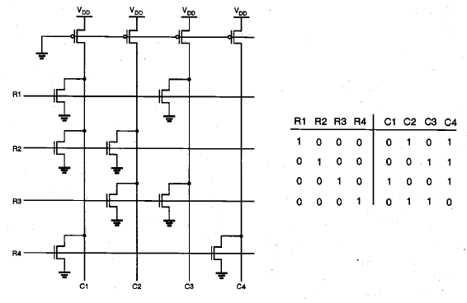
NOR based ROM memory

Slide 9
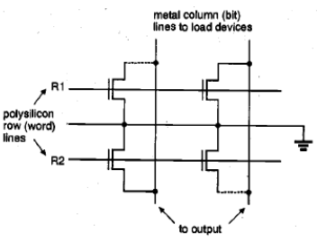
Chip fabrication

Slide 10
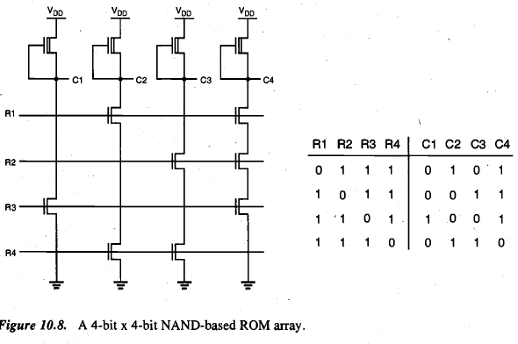
NAND based ROM memory

Slide 11
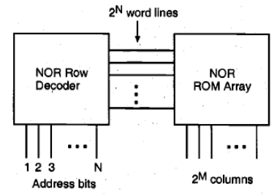
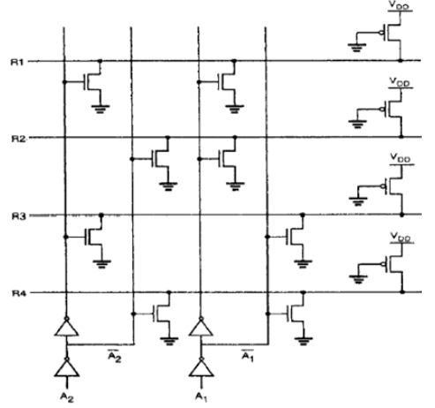
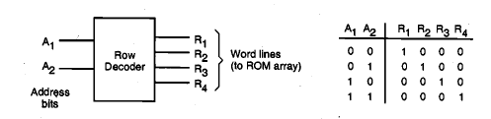
NOR based Row decoder

Slide 12
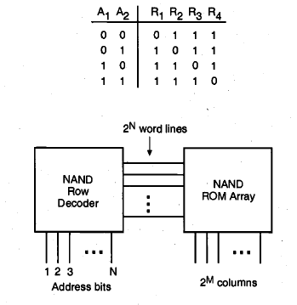
NAND based row decoder

Slide 13
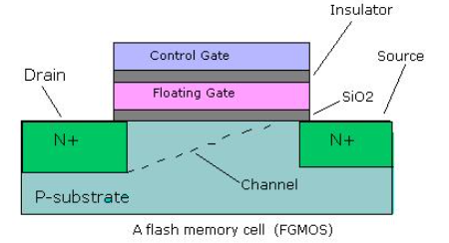
Flash memory (Nonvolatile)
Flash memory is a type of electrically erasable programmable read-only memory [EEPROM] chip that can be used for the transfer and permanent storage of digital data.
Flash memory consists of one transistor with floating gate whose threshold voltage can be programmed repeatedly by applying an electrical field.
The transistor can have two threshold voltages.

Slide 14
Flash memory
Flash memory architecture includes a memory array stacked with a large number of flash cells.
A basic flash memory cell consists of a storage transistor with a control gate and a floating gate, which is insulated from the rest of the transistor by a thin dielectric material or oxide layer.
The floating gate stores the electrical charge and controls the flow of the electrical current.
Electrons are added to or removed from the floating gate to change the storage transistor's threshold voltage. Changing the voltage affects whether a cell is programmed as a zero or a one.

Slide 15
Flash memory
The cell data is programmed by storing or ejecting electrons in the floating gate through a mechanism called Fowler-Nordheim tunneling or channel hot-electron injection.
With Fowler-Nordheim tunneling, data is erased via a strong negative charge on the control gate. This forces electrons into the channel, where a strong positive charge exists.
The reverse happens when using Fowler-Nordheim tunneling to trap electrons in the floating gate. Electrons manage to forge through the thin oxide layer to the floating gate in the presence of a high electric field, with a strong negative charge on the cell's source and the drain and a strong positive charge on the control gate.

Slide 16
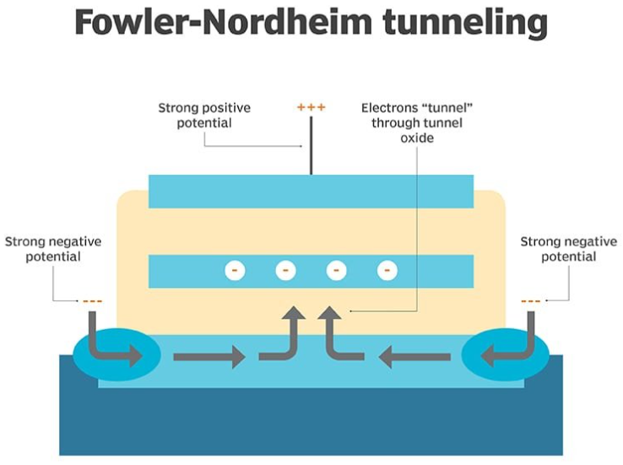

Slide 17
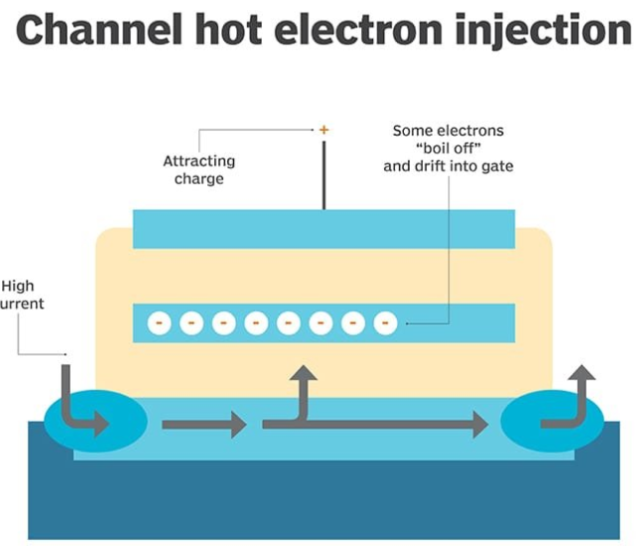
Channel hot-electron injection
Channel hot-electron injection, also known as hot-carrier injection, enables electrons to break through the gate oxide and change the threshold voltage of the floating gate.
This breakthrough occurs when electrons acquire a sufficient amount of energy from the high current in the channel and the attracting charge on the control gate.

